Slide 1
Software Design SOLID and GRASP

Slide 2



What is a good software design ?

Slide 3
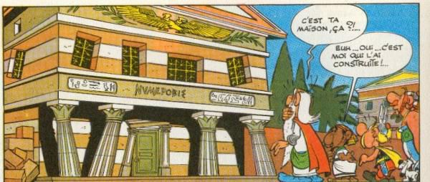
TINHIWHDI principle
Not just one solution to a design problem
How do you decide for the most appropriate ?
Principles and patterns

Slide 4
OOP and SOLID Principles
Single Responsibility
Open/Closed Principle
Liskov Substitution
Interface Segregation
Dependency Injection

Slide 5
Single Responsibility
A class should have one and only one reason to change
Or the class should implement only one functionality

Slide 6
Open/Closed Principle
Software entities should be Open for extension but Closed for modification

Slide 7
Liskov Substitution Principle
Let Φ(x) be a property provable about objects x of type T. Then Φ(y) should be true for objects y of type S where S is a subtype of T. (Data Abstraction – 1987 – Barbara Liskov)
Instances of a superclass should be replaceable by instances of a subclass
Example :
Shape, Rectangle and Square
Bird, Dove and Penguin
Be careful with input and output parameters

Slide 8
Interface Segregation Principle
Clients should not be forced to depend upon interfaces that they do not use.

Slide 9
Dependency Inversion
High-level modules should not depend on low-level modules. Both should depend on abstractions.
Abstractions should not depend on details. Details should depend on abstractions.

Slide 10

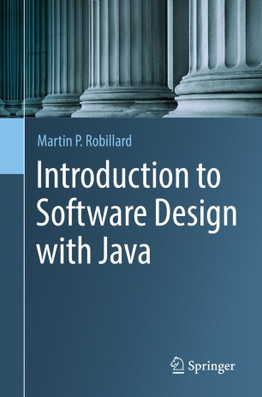
Grasp Patterns
Recognize that according to Craig Larman:
“The skillful assignment of responsibilities is extremely important in object design,
Determining the assignment of responsibilities often occurs during the creation of interaction diagrams and certainly during programming.”

Slide 11

GRASP
During Object Design
Make choice about the assignment of responsibilities to software classes

Slide 12
What is a responsibility
It’s not a method
It’s the abstraction of a behavior
Responsibility of knowing things
A value, a collection of values, a derivation based on value (age from date)
Responsibility of doing things
Orchestrate actions
Create new objects
Delegate to other objects

Slide 13
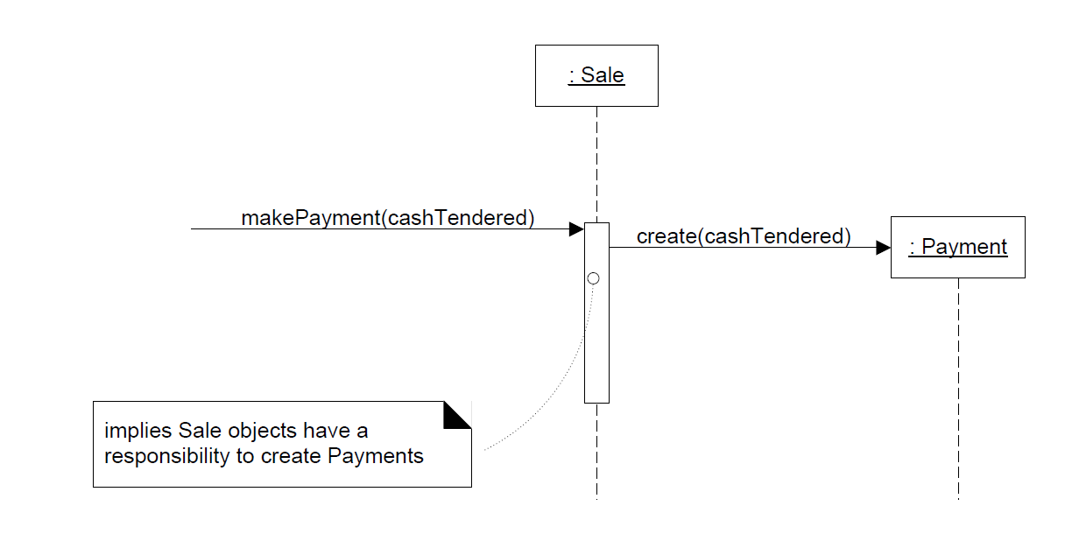
Responsibility

Slide 14
Information Expert
Sale example
Who is responsible for knowing the total of the sale ?
Who has the information to determine the total ?

Slide 15
Information Expert
Look in the Domain Model
Domain Model : conceptual classes
Design Model : software classes
So
Choose a domain model class
Create a new class based on Domain Model class

Slide 16
Expert– Using Domain Model
There is a Sale class in the domain model
Sale
date
time
1
Contains
*
Product
Specification
SalesLineItem
*
1
quantity
Described by
description
price
itemID

Slide 17
Add Sale Class to the design model
Add the responsibility of knowing its total
Method getTotal()
:Sale
date
time
New method ------→
getTotal()
t := getTotal()
: Sale

Slide 18
And then
What information is needed to determine the line item subtotals?
We need: SalesLineItem.quantity and
ProductSpecification.price
:Sale
date
time
getTotal()
t := getTotal()
1 *: st := getSubtotal()
: Sale
: SalesLineItem
:SalesLineItem
quantity
getSubtotal()

Slide 19
How the domain model is used
And we need to know the product price
The design class must include a method getPrice()
The design classes show how entities are used

Slide 20
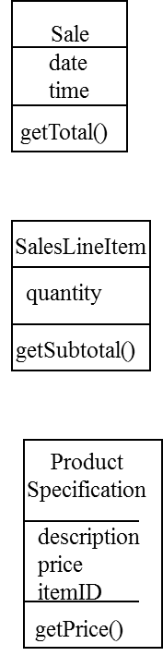
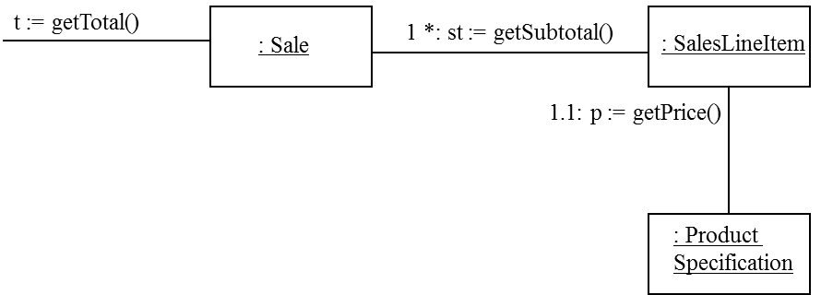
Finally
Responsabilities are placed with the object that had the information needed to fulfill it

Slide 21
Design Model considerations
Often requires spanning several classes
Collaboration between partial information experts
these “information experts” do things relative to the information they ‘know.’

Slide 22
Be careful
Who should be responsible for saving Sale in the database ?
Each entity cannot be responsible for that
Break several SOLID principles

Slide 23
Cohesion and Coupling
SQL/JDBC Code in the Sale Class
It is not anymore only a sale (decreased cohesion)
This is a new responsibility (saving itself)
(Separate I/O from data manipulation)

Slide 24
Cohesion and coupling
Coupling Sale with the database service
Sale belong to the domain layer
Coupled to other domain objects
Difficult to change the storage service

Slide 25
Final : be careful
Keep application logic in one place
Keep database logic in another place
Separation of concern is good for cohesion and coupling

Slide 26
Benefits of information expert
Maintain encapsulation
Supports low coupling
Behavior distributed accross classes that have the required information
High cohesion, Better reuse

Slide 27

Creator
Who is responsible for creating new instances of some classes

Slide 28
Solution
Assign class B the responsibility to create an instance of class A if one or more of the following is true:
B aggregates A (simple aggregate; shared attributes)
B contains A (composition; non-shared attributes)
B records instances of A objects
B closely uses A objects
B has the initializing data that will be passed to A when it is created (thus B is an Expert with respect to creating A)
e.g. queue collection class; queue driver class; stack ….
If more than one option applies, prefer a class B which aggregates or contains class A.

Slide 29
Creator
Creation of objects is very common
We have a State class and we create instances of State objects, or
We have a CD class, and we create instances (an array?) of CD objects….
Creator results in low coupling, increased clarity, encapsulation and reusability

Slide 30
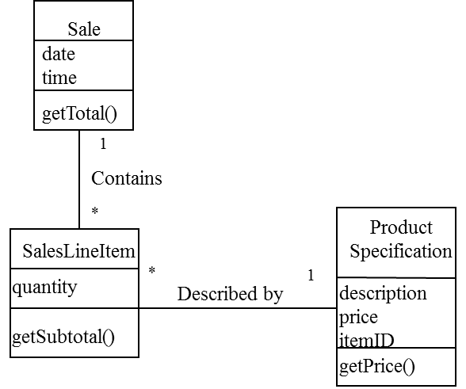
Creator Example
Who is responsible for creating SalesLineItem

Slide 31
Sale aggregates SalesLineItems
Sale is a good candidate to have the responsibility of creating SalesLineItems
Seems very obvious

Slide 32
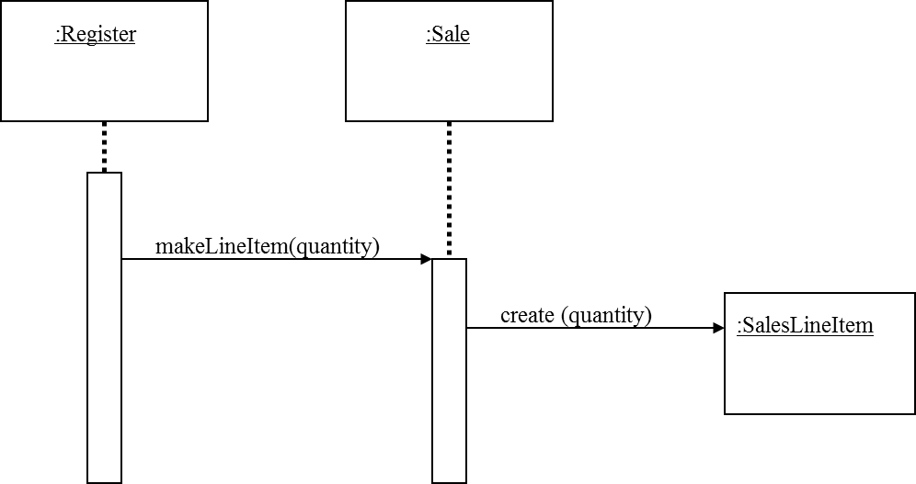
The sequence diagram helps

Slide 33
Benefits
Creator connected to the created object
Creator has the initializing data needed for the creation
Cf Larman book
Creator is a kind of expert

Slide 34
Creator
Sometimes it is better to delegate creation to a helper Class
The Factory design pattern

Slide 35
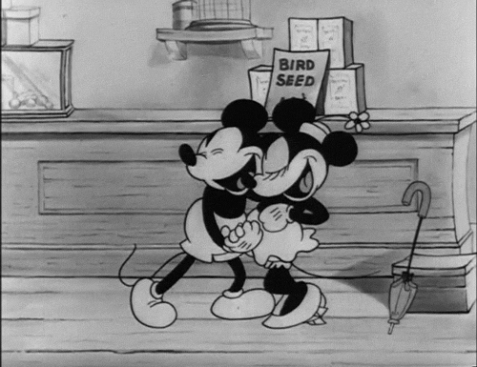
Low Coupling
Assign a responsibility to keep the coupling low
Support low dependency, low change impact and increased use
High coupling is not desirable
Hard to change, understand, reuse

Slide 36
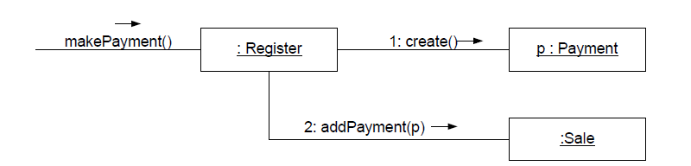
Example
Register is coupled to payment

Slide 37
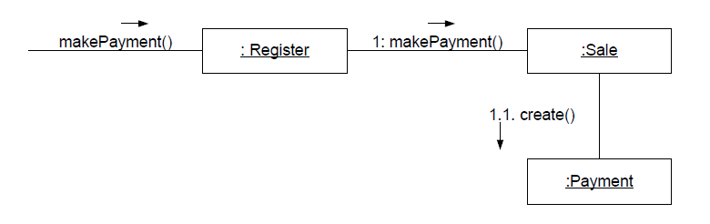
Alternative
Payment known from Sale. Sale has to know Payment

Slide 38
Common form of coupling
TypeX has an attribute that refers to TypeY
TypeX instance call a service on a TypeY instance
TypeX has a method that references an instance of TypeY (parameter, local variable)
TypeX is a subclass of TypeY
TypeY is an interface and TypeX implements it

Slide 39

High Cohesion
Assign responsibility to keep cohesion high
Measure of the relation between an element responsibilities
Low cohesion mean
Hard to comprehend, reuse and maintain

Slide 40
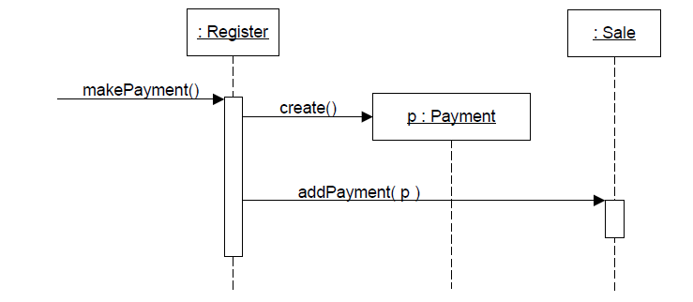
Example
Register creates payment

Slide 41
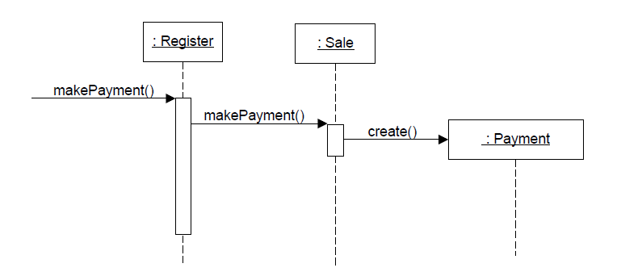
Same alternative
Register has less responsibilities – Higher cohesion

Slide 42
Controller
Assign the responsibility for handling event message
Facade Controller
Use Case or Session controler
This is not a UI class
Who is responsible for handling input system event

Slide 43
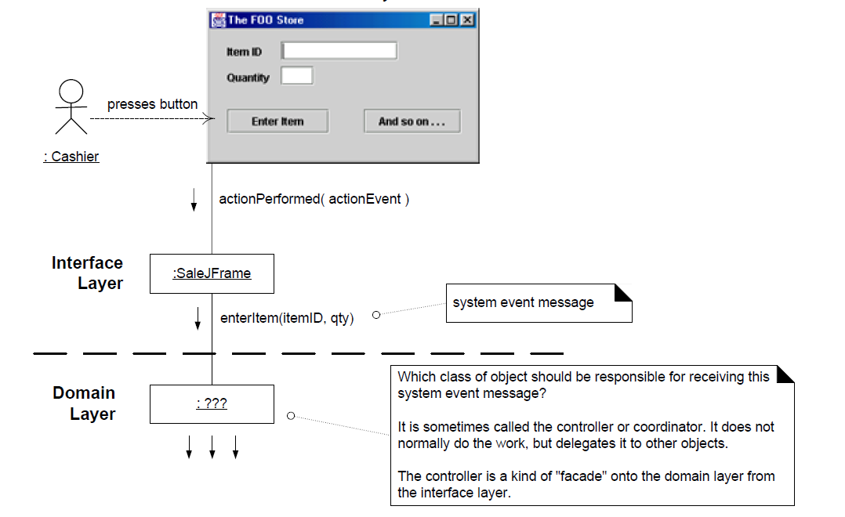
Example

Slide 44
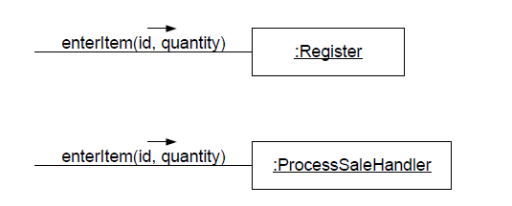
Two possibilities

Slide 45
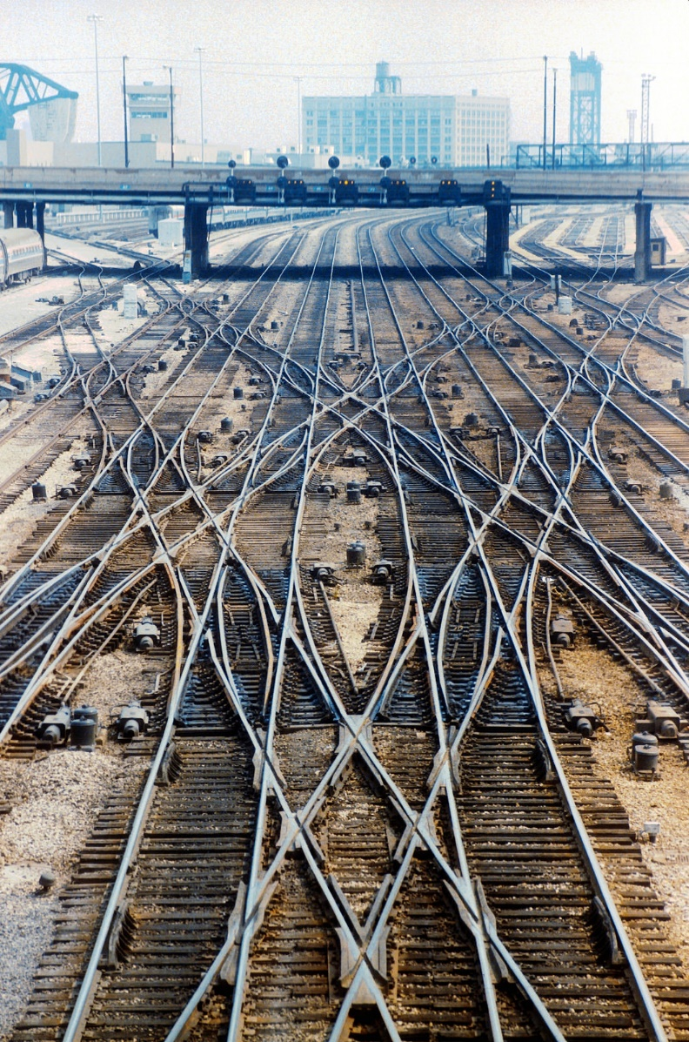
The controller delegates
It does not do the work by itself
It coordinates/controls the activity

Slide 46
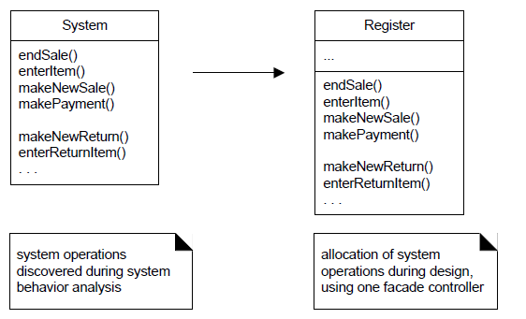
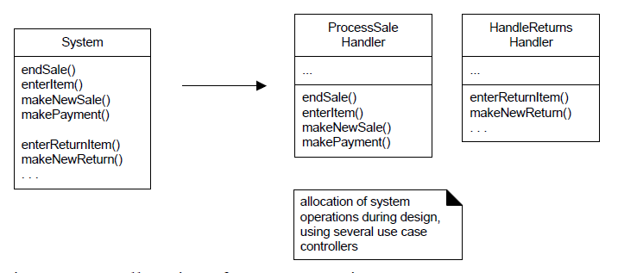
Allocation of operations

Slide 47
Issues
Avoid bloated controllers (low cohesion)
Add more controllers
The controller delegates the responsibility to fulfill operation on to other objects.

Slide 48
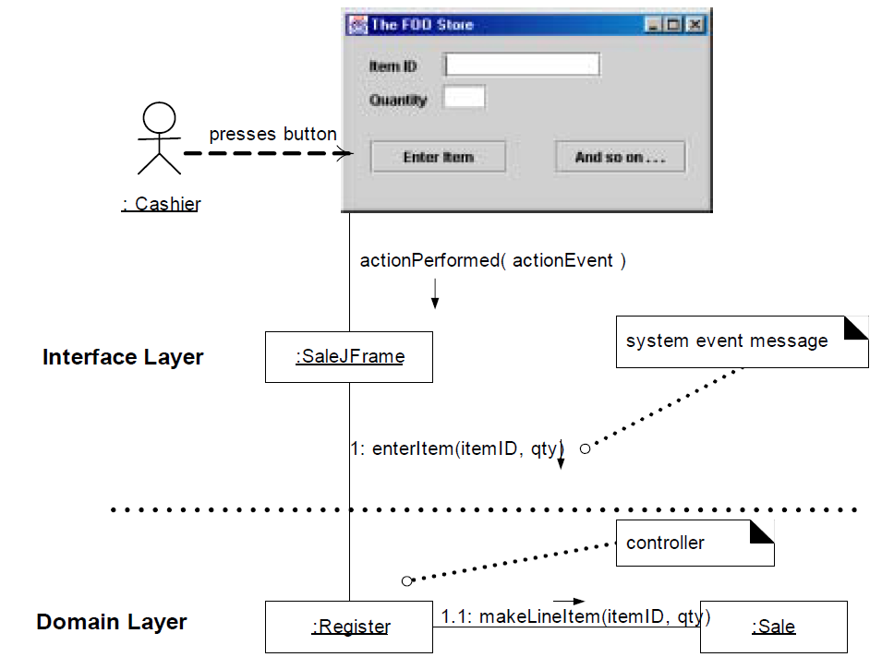
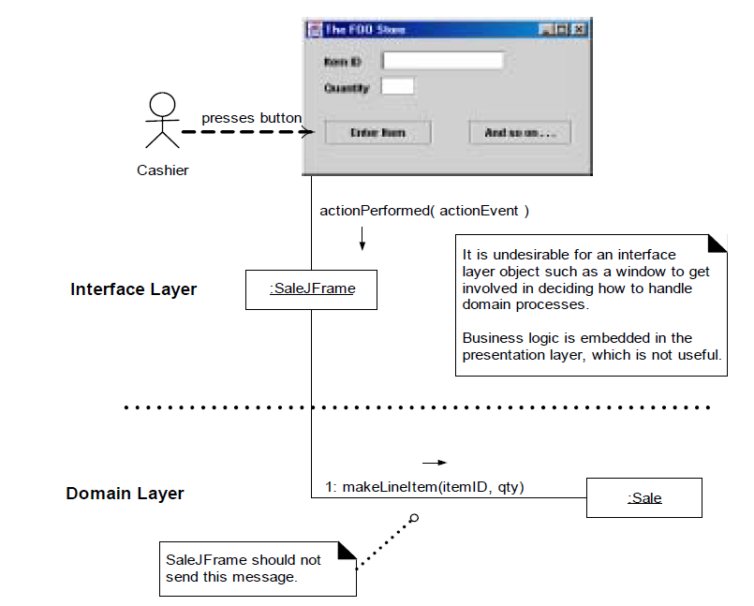
Two couples

Slide 49
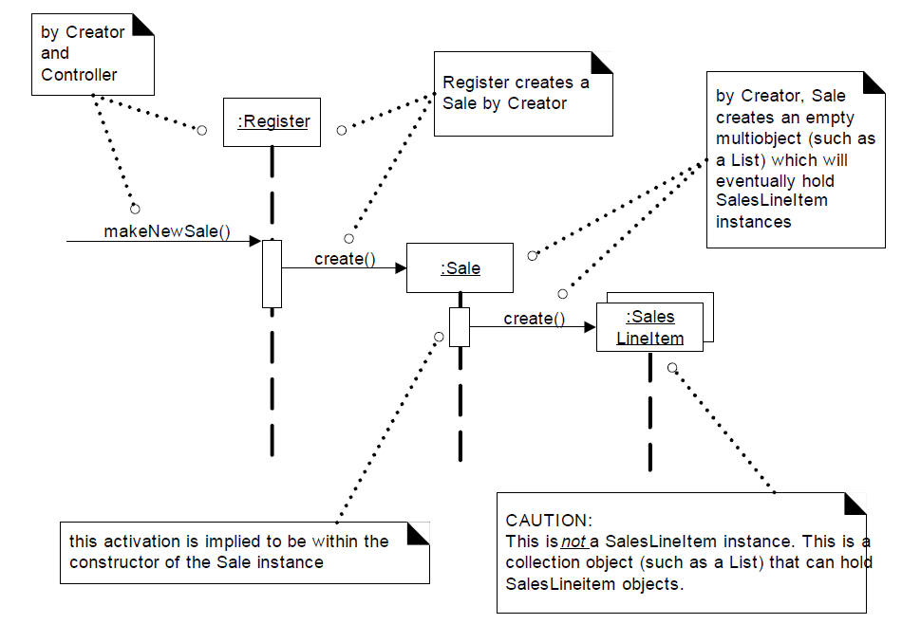
Creating a Sale

Slide 50
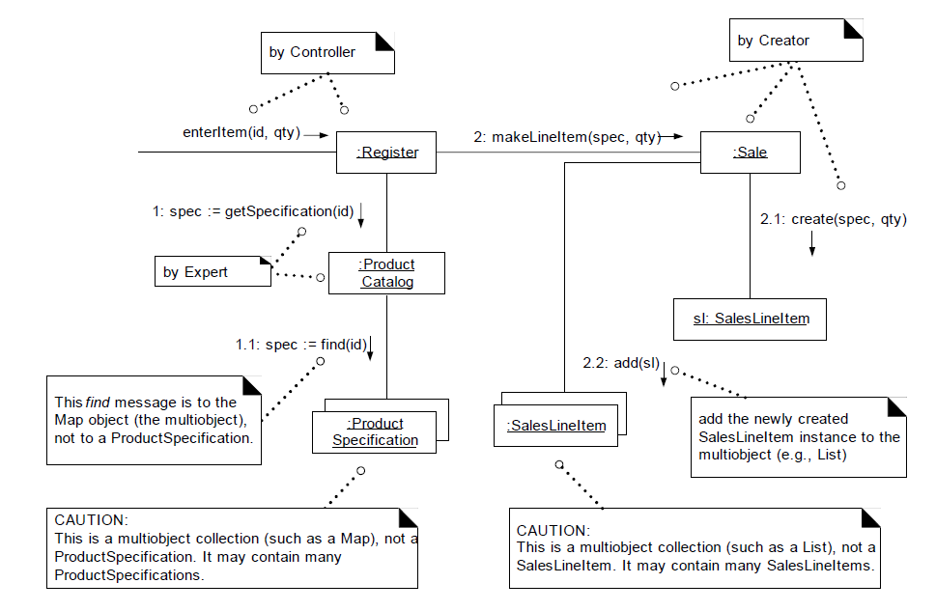
Enter an Item to the Sale

Slide 51
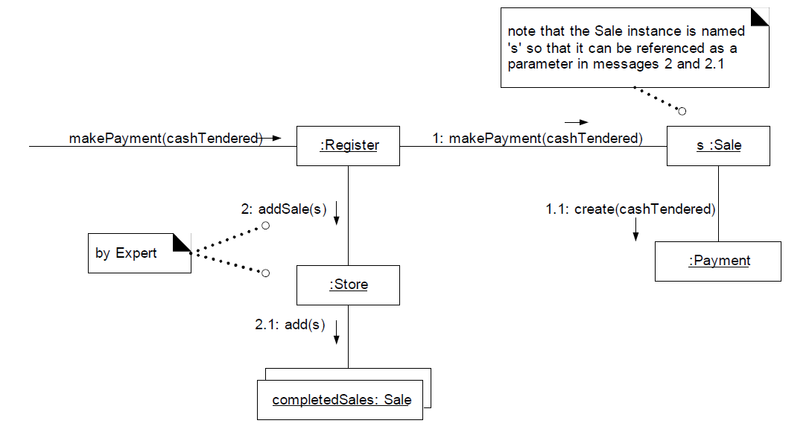
Making payment

Slide 52
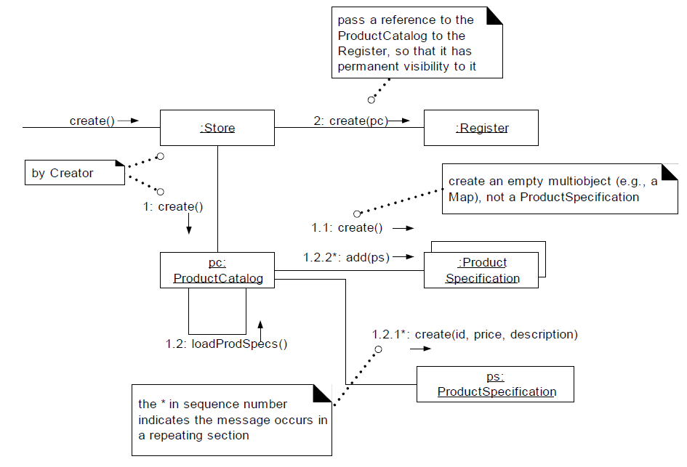
Initialisation

Slide 53
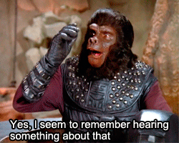
Remember
Low Coupling/High Cohesion
Expert
Creator
Controller
Guide for design decision.

Slide 54
Resources
www.unf.edu/~broggio/cen6017/38.DesignPatters-Part2.ppt
www.academic.marist.edu/~jzbv/.../DesignPatterns/GRASP.pp
…

